Slide 1




FRONT-END DEVELOPMENT
ASSIGNMENT 3 TEMPLATE
STUDENT NAME: Hariharan S
YEAR: II
COLLEGE CODE:1455
COLLEGE NAME: Tagore College of Arts and Science
DEPARTMENT: Computer Science
SEMESTER: IV
ROLL NO: unm1455222407723
NMID: 614D89761591EB584744FC4BCEE6FE5F
DATE: 10/03/2026
PROJECT TITLE: JavaScript Interactivity for Event Registration
1. Problem Statement:
Small event organizers need a way to ensure the data they collect is accurate and to see registrations update instantly without refreshing the page. While Assignment-2 focused on look and feel, this assignment adds functionality to validate user input and dynamically manage participant lists.
2. Objective:
To implement JavaScript for client-side validation and DOM manipulation. The goal is to ensure only correct data is submitted and to provide immediate visual feedback by updating the "Registered Students" table automatically.
Requirements:
This section details the functional requirements implemented to move the project from a static design to an interactive web application:
Form Validation:
Mandatory Checks: Wrote conditional logic in script.js to verify that Name, Date of Birth, and College fields are not empty.
Format Verification: Used string methods to check for the presence of the "@" symbol in the Email field and ensured the Phone number contains exactly 10 digits.
Selection Logic: Added checks to confirm that an event has been chosen from the dropdown and that both Gender and Mode radio buttons have a "checked" status.

Slide 2
3.2 Confirmation Checkbox Validation:
Prerequisite Check: Implemented an if statement to check the .checked property of the declaration checkbox.
Error Prevention: If the checkbox is unselected, the script triggers a warning alert and halts the submission process to ensure user agreement.
3.3.Dynamic Display of Registered Participants:
Data Extraction: Programmed the script to capture values from textboxes, selected radio buttons, and the dropdown menu simultaneously upon submission.
DOM Table Updates: Used the insertRow() and insertCell() methods to create a new row at the bottom of the existing table for every successful registration.
3.4 Prevent Page Reload:
Event Interception: Utilized the e.preventDefault() method within the form's onsubmit function.
Seamless Experience: This prevents the browser from refreshing or navigating away, allowing the participant table to update instantly while keeping all current session data intact.
3.5 Clear Form After Successful Submission:
State Reset: Used the .reset() method on the form object to clear all input fields after the data has been safely moved to the table.
Validation Cleanup: Added a loop to remove "redBorder" or "greenBorder" CSS classes from all inputs, returning the form to its original blank state.
3.6 Display Success Message:
Visual Confirmation: Directed a "Registration Successful!" message to a dedicated statusMsg div with green text styling.
Auto-Removal: Applied setTimeout() to automatically clear the success message after 3 seconds to keep the interface clean.
3.7 Input Field Feedback:
Visual Cues: Programmed the script to dynamically assign CSS classes (redBorder for errors or greenBorder for valid data) based on validation results.
Instant Correction: This provides the user with immediate visual confirmation of which fields need correction before they can proceed.

Slide 3
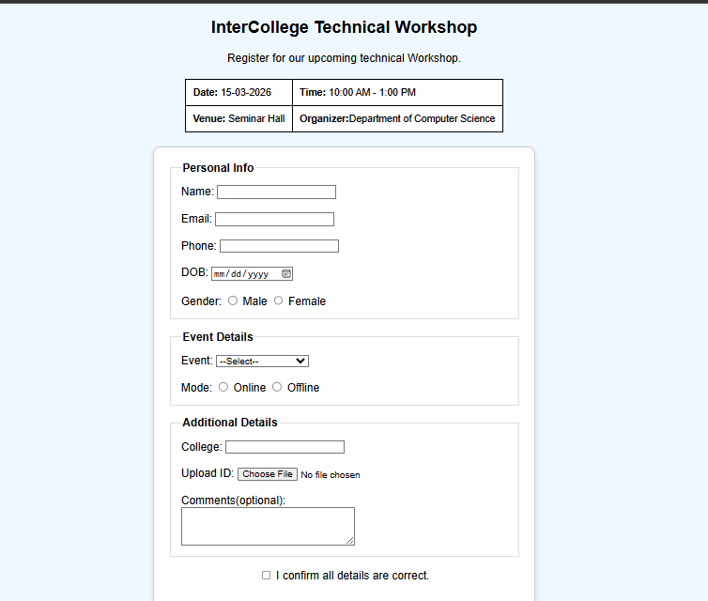
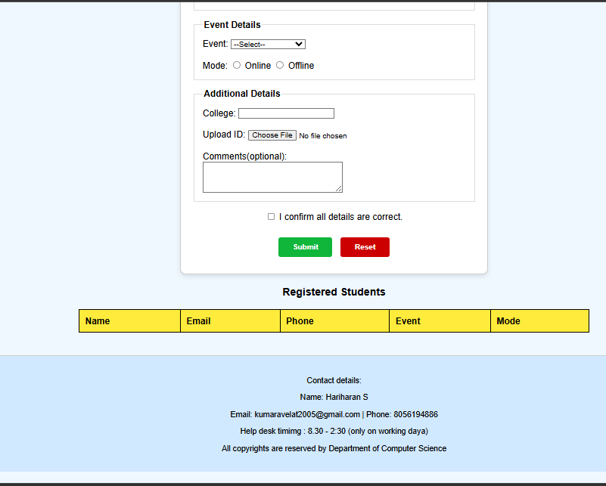
3.8 Optional Enhancements:
File Upload Validation: Included a check to ensure an ID proof file has been selected before the form is considered complete.
Consistent Formatting: Ensured that the dynamically added data in the table maintains the same professional alignment and styling as the header row.
4.JavaScript Concepts Used:
DOM Selection: Used document.getElementById to access form inputs and the table.
Event Listeners: Applied .addEventListener('submit', ...) to handle user actions.
Conditional Logic: Used if-else statements to check for valid input formats.
Array/Object Handling: Captured form values into variables before inserting them into the table.
Function Definitions: Created reusable functions for validation and table updates.
5. Implementation Steps:
Script Link: Connected the external script.js to the HTML file.
Validation Logic: Wrote functions to verify email patterns and phone number lengths.
Submission Handler: Prevented the form's default reload behavior to keep the dynamic data visible.
Table Insertion: Used insertRow() and insertCell() to add the new participant details to the bottom table.
Cleanup: Triggered the reset() method to prepare the form for the next user
6.Output:

Slide 4
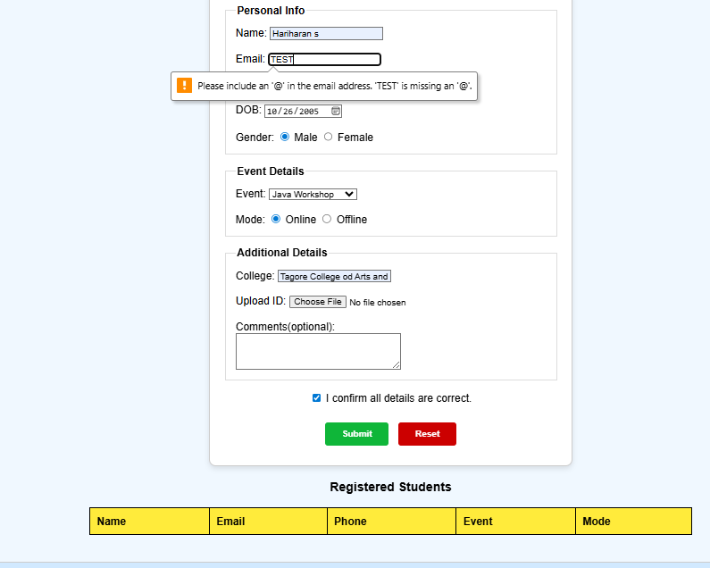
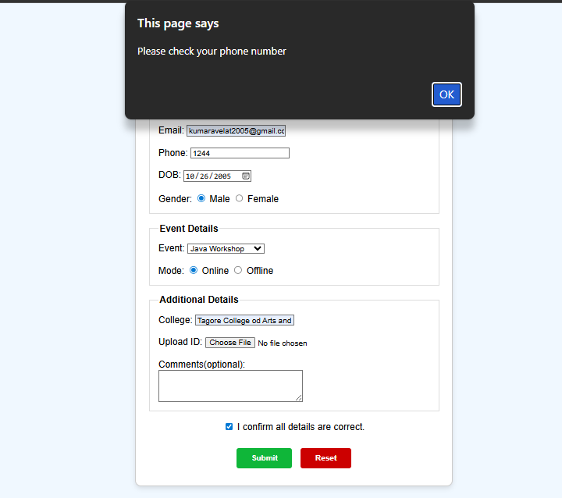
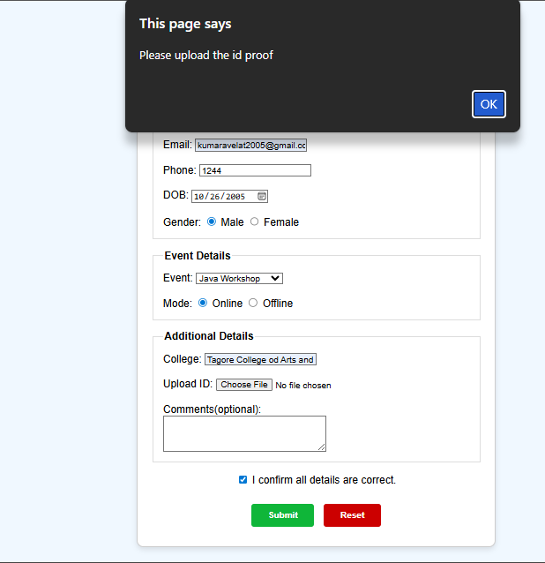
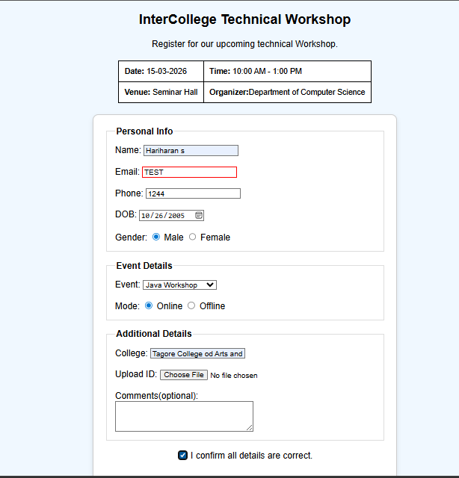

Slide 5
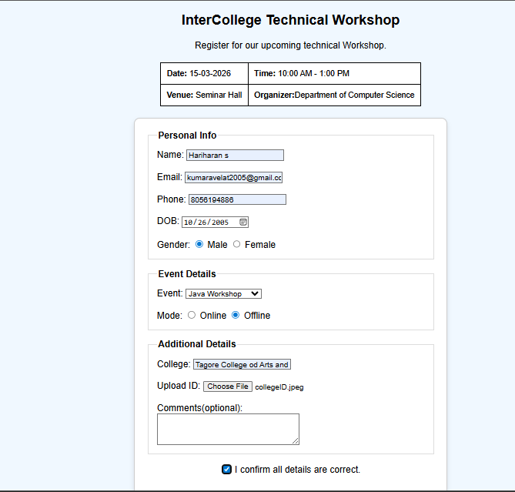
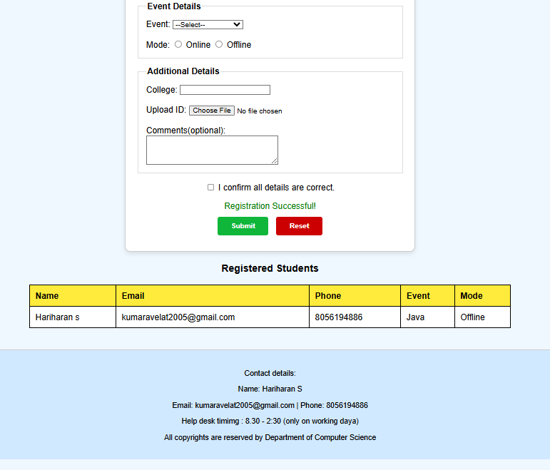
After submit
Before submit
7.Learning Outcome:
Interactivity: I learned how to move beyond static styling and create a functional web application using JavaScript.
Data Integrity: I understood how to enforce rules on user input to ensure the database (or table) only receives correctly formatted information.
DOM Skills: I gained confidence in manipulating the Document Object Model to change page content dynamically without a server.
8. Conclusion:
The project successfully integrates HTML, CSS, and JavaScript to form a complete registration system. The validation logic ensures data quality, while the dynamic table update provides immediate satisfaction to the user, proving that client-side scripting is essential for a modern web experience.

